Slide 1



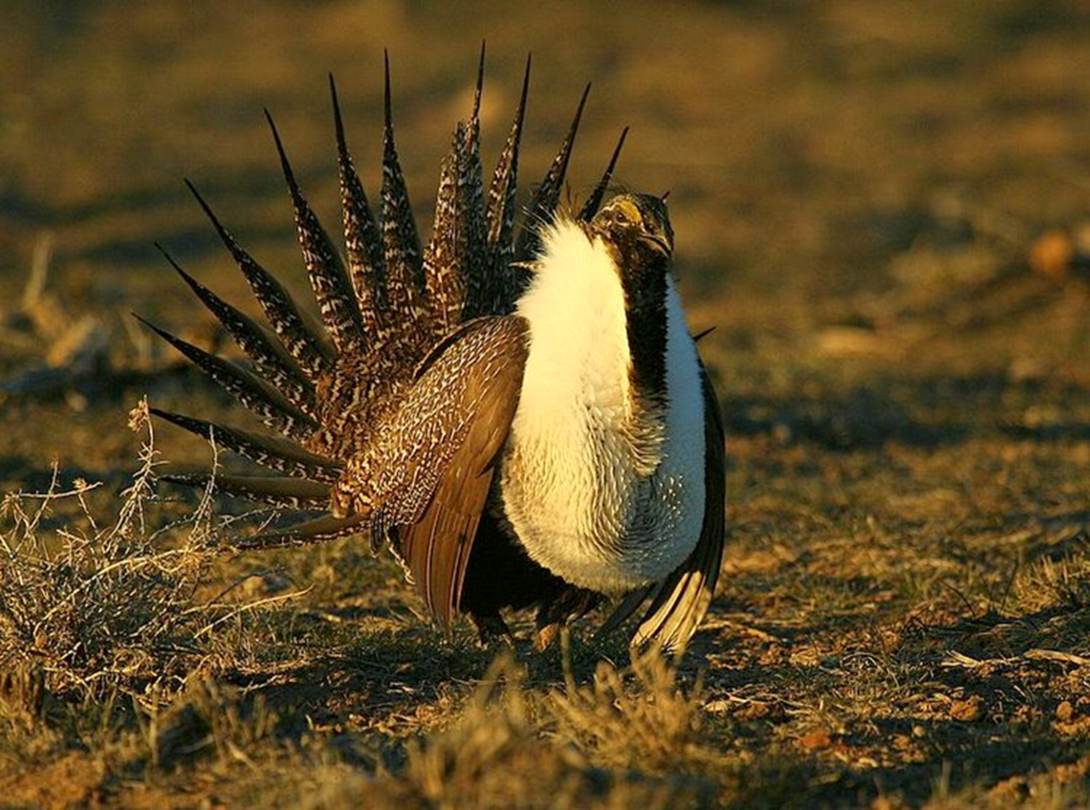
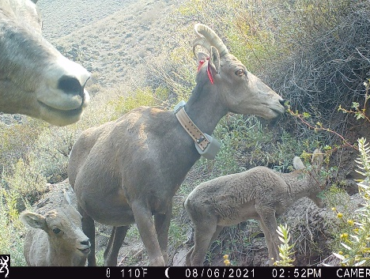
Nevada Chapter of
The Wildlife Society
2023 Science Symposium
February 28 – March 1
Nevada Department of Wildlife Conference Room
1100 Valley Rd., Reno, NV
(Wildlife Presentations and Business Meeting)
Reception: Louis' Basque Corner
Feb 28th, 6:00PM
(Included with Registration)
Registration open to everyone!
Register at: https://user.tws-west.org/store.php?e=NVSS2023
Fee: $50 NV Chapter members
$60 Non-members (includes membership)
$20 students
To present: please submit an abstract to
twsnevada@gmail.com by Feb 15th
Please submit an abstract for an oral presentation. Presentations may focus on the study, management, or conservation of wildlife and habitats. Priority will be given to studies occurring in Nevada. Presentations may consist of either final or interim results of original research or management.
Please use the abstract form for submission (attached).

