Slide 1
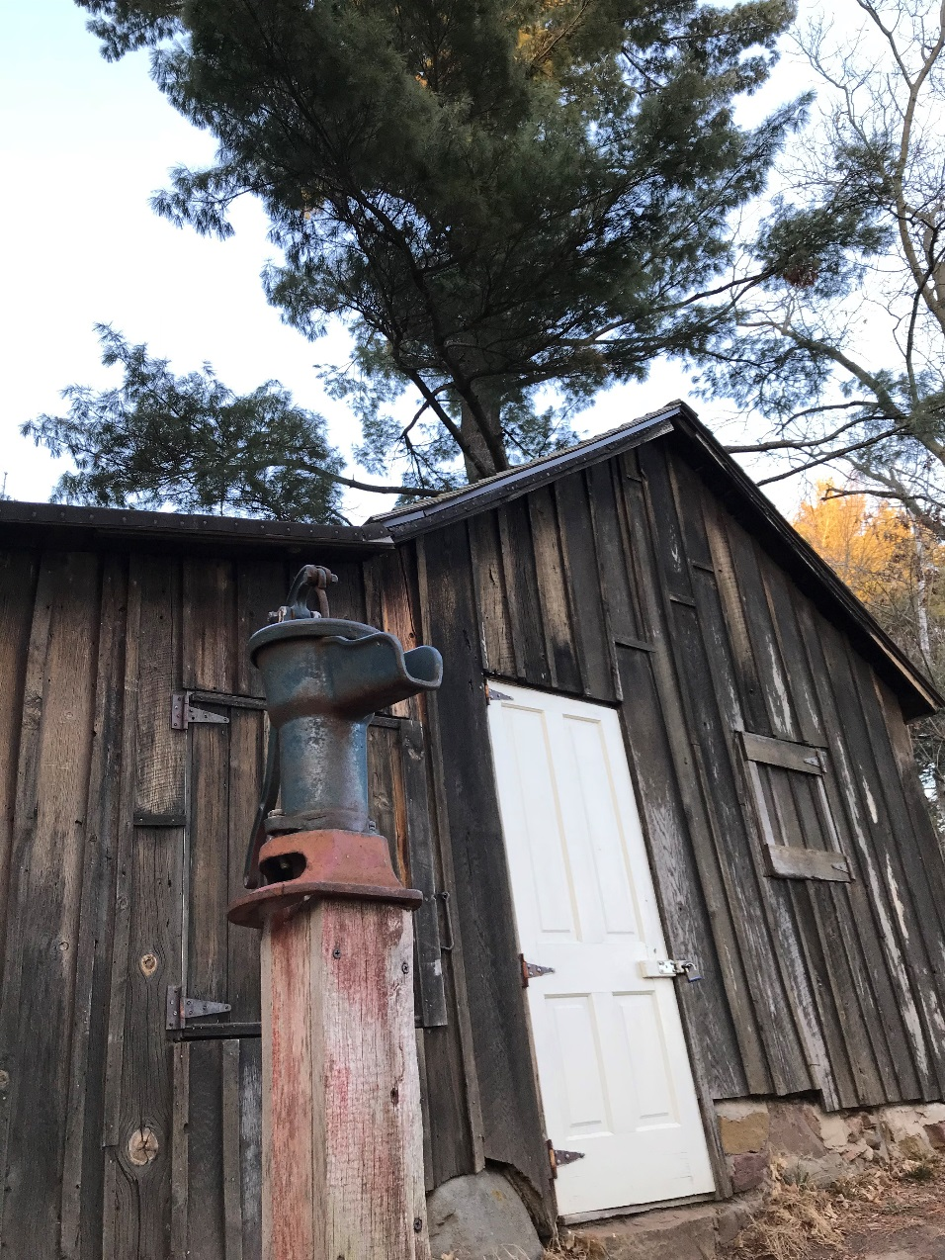
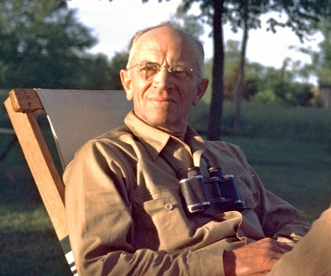
Building a Strong Wildlifer Community within Our North Central Section -
We are the Cogs & Wheels,
We are The Wildlife Society
Jodie Provost Past TWS North Central Section President
Gary Potts Past TWS President
Notes:
This presentation was first created for WI TWS meeting Feb. 2019 by Jodie Provost with input from Gary Potts, who both serve on the Membership Committee which developed it for State Chapters Presidents to increase membership and involvement. The NCS Membership will update it annually. Please feel free to tailor and update it to meet your needs and style, and add your name to the title slide.
Thank you for inviting me! This is the Leopold Shack Jan. 2018. Stopped on the way to Midwest F&W Conf. in Milwaukee – was spiritual!

Slide 2
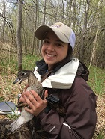
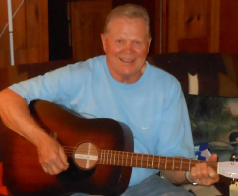
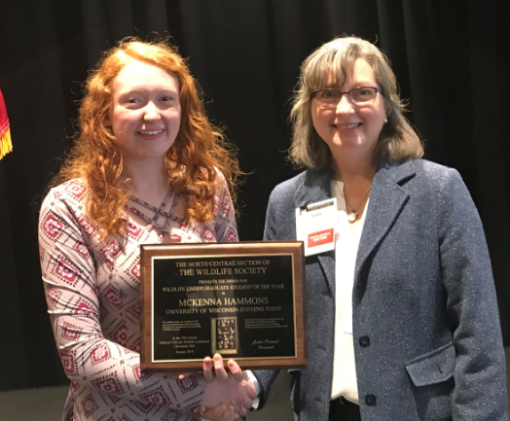
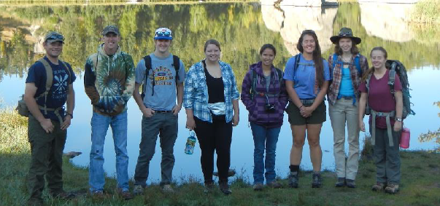
What is The Wildlife Society?
People! With a feeling of belonging, that we matter to one another and to our organization, with shared faith that our needs will be met through our commitment to stand together = A Community of Wildlifers
Notes:
People! You’ll notice there are not many wildlife photos in this presentation. The top 5 photos include WI folks. Change these to reflect the state chapter your are visiting. The bottom photo is a panorama of the 2018 Midwest student/professional mixer at Cleveland (included trivia in teams at tables) . Note Gary Potts and Jon Cepek at far left by NCS table and poster. Ollie Torgerson is on the guitar.

Slide 3
Our TWS North Central Section (NCS) Mission:
To inspire, empower, and enable wildlife professionals within the NCS to sustain wildlife populations and habitats through science-based management and conservation.
2018 MN TWS Habitat Restorations Workshop, Crow-Hassan Park Reserve
Visit wildlife.org/ncs today!
Notes:
Founded in 1937, TWS is an international organization of nearly 10,000 scientists, managers, educators, technicians, planners, consultants, students and supporters committed to addressing national and international issues that affect the current and future status of wildlife in North America and throughout the world.
Mission: To inspire, empower, and enable wildlife professionals to sustain wildlife populations and habitats through science-based management and conservation.

Slide 4
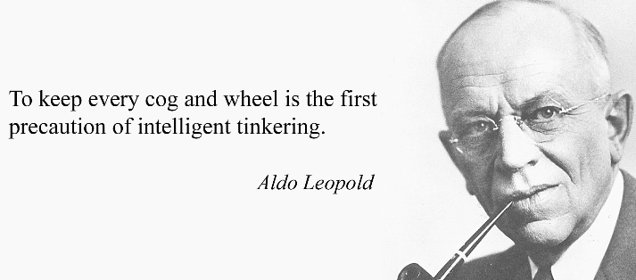
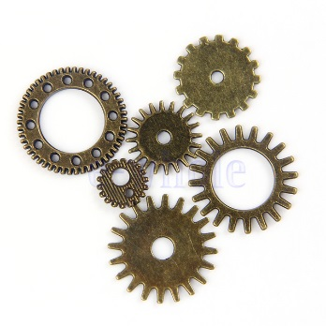
Together, as a Community, We are Stronger.
We are those cogs and wheels. When we strive to be the best Wildlifers we can be, & to be inviting, diverse, & focus on the strengths we can each bring, our community is more functional, effective, resilient.
Notes:
Like an ecosystem, when more Wildlifers are present and contributing, our system, our web is stronger, works better, and our mission more achievable. Some of us are wheels, turning along smoothly and steadily, and other are cogs pushing, encouraging, supporting –together we get it done!

Slide 5
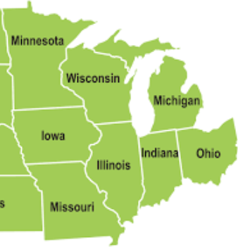
What is the North Central Section?
Our Midwest
Wildlifer Community
In 1961, IL, IN, IA, MI, MN, MO, OH and WI organized into NCS to -
provide a formal means to inform TWS Rep to Council of members’ wishes
encourage formation of additional State Chapters - strong Chapters are our foundation!
provide more opportunity for direct participation in Society affairs
strengthen relationships between state, federal, university, and private interests, and
- allow formation of committees to address local, state, and regional issues.
Notes:
Involvement in NCS will not detract from your Chapter, only add value! Broaden the connections and possibilities!

Slide 6
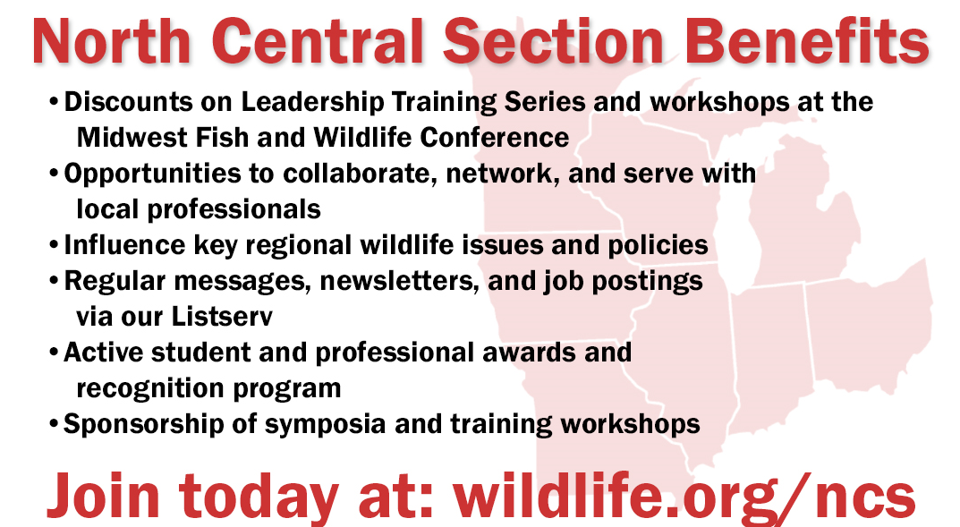
The Value of NCS
NCS is a tool
to make your TWS Chapter
even stronger
Notes:
NCS can grease those state cogs and wheels! Our new business card developed fall 2018. We will visit about investing in yourself, your community, and the future of conservation. Membership team revived due to decline numbers. This committee/team is a standing committee as noted in the NCS Operations Manual and Bylaws. It had been inactive. Due to a drop in NCS membership (290s recently in late January, was 800-900 in 1995), we have chosen to revive it. In the past, there has been 1300-1400 members in the Section that are national TWS members, but many are not NCS members. 2016 national TWS membership in the eight states equaled 1440. Not only is a larger, active, engaged, satisfied membership desired, but membership dues are the one source of NCS income (currently $20/year, was $10/year until a few years ago). A poll showed that 5 of the 8 states had only 14-31% of their state members also NCS members.

Slide 7
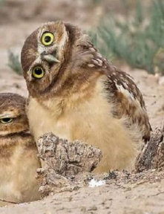
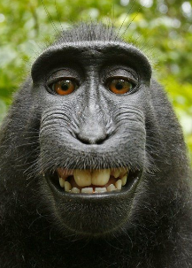
The Value of NCS
- A Smart Investment in You
- Opportunity to collaborate, network and serve with fellow professionals from
around Midwest – think jobs, career dev., funds, habitat & research projects...
- Workshops & Training at Midwest Fish & Wildlife Conference, discounts for
NCS members ($30-50 off on TWS Certification & Climate Change Workshops this year)
Notes:
Can update Midwest image and workshops offered. Easy to clip photos from TWS and NCS websites and newsletters, etc. as needed.
Note discounts are greater than our $20 dues!

Slide 8
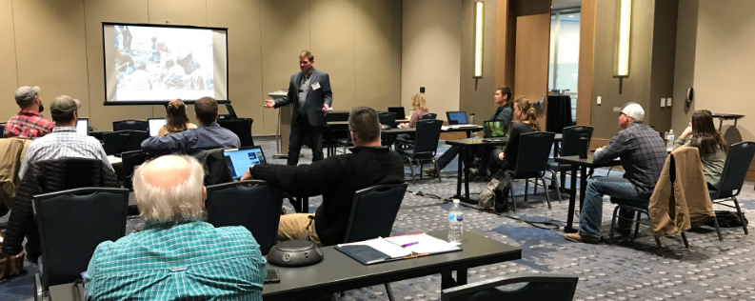
NCS Professional Development Fund
Developed to support continuing education activities.
Individual members, companies, organizations, and State Chapters provided funds several years ago.
Team wishes to maintain and find ways to build it more, to ideally use interest.
Currently sits at $44,400.
Notes:
Our TWS Certification workshop by Tim VanDeelen at 2019 Midwest FWC in Cleveland – get certified and show CWB or AWB proudly! You’ll be glad you did.

Slide 9
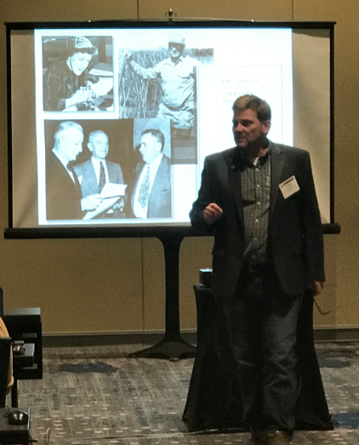
NCS Leadership Workshop Series
Led by the philosophy that all can be leaders
Held annually at Midwest FWC in partnership with Midwest Association of Fish & Wildlife Agencies
Workshops to date
2016 – Leadership, Grand Rapids, MI
2017 - Wildlife Governance, Lincoln, NE
2018 – Adaptive Leadership, Milwaukee, WI
2019 – TWS Certification, Cleveland, OH
2020 - ?, Springfield, IL
2021 - ?, MN
Future Workshops - Please share your ideas/needs!
Notes:
Update this slide as Leadership trainings offered. Would like to begin sponsoring webinars.
Photo is Dr. Tim VanDeelen giving TWS Certificaiton Workshop at Midwest FWC in Cleveland Jan. 2019 . Also TWS Leadership Institute class of 2019 opportunity (apps due March 24)

Slide 10
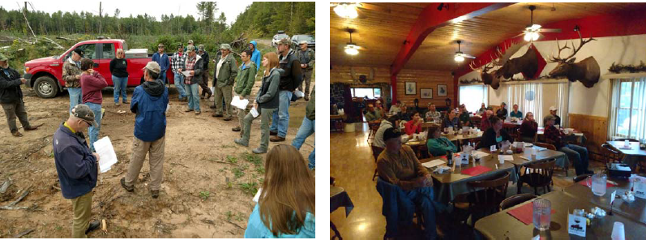
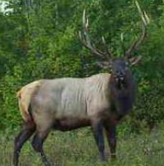
The Value of NCS -
A Smart Investment in Your Wildlife Community
- Chapter benefits such as support to WI TWS Fall Elk Workshop, MI TWS Annual Mtg., IN TWS Annual Mtg. & 50th Anniversary,...
Requests taken for up to $250 from Chapter, must show service to NCS, can get funds every 2-3 yrs, preference to new funding requests, request application is on NCS website.
Notes:
Update photos of state chapter and their activities that have benefited as needed.
Can benefit State Chapters – requests taken for up to $250 annually from Chapter, must show service to NCS, can get funds every 2-3 yrs only, preference to new funding requests, complete application on the website
These photos are the WI fall 2018 technical workshop reg. elk mgt. was supported

Slide 11
Our NCS Listserv
All members have access to send and receive relevant, appropriate messages that advance our work and mission - NCSTWS@list.msu.edu
Job postings
Funding opportunities
Meeting, Training and Workshop announcements
Problem solving – ask questions, share equipment, etc.
Conservation Affairs Network monthly newsletter & Action Alerts
Our NCS Spring and Fall Newsletter
Reminders on Awards, Voting, etc.
Notes:
Our listserv can be a very useful communication tool if we use it! Give some recent examples of productive use.

Slide 12
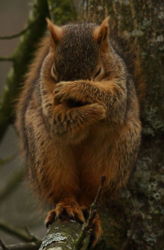
Voting Privileges
Don’t miss the chance to shape your Section, your Community! Or...
Notes:
Who do you want to lead your ecosystem? Bottom is a link in the NCS newsletter to candidate bios and voting. (Also a reminder sent on our NCS listserv.) Change these photos of officers as needed. They were clipped from the NCS website board web page.

Slide 13
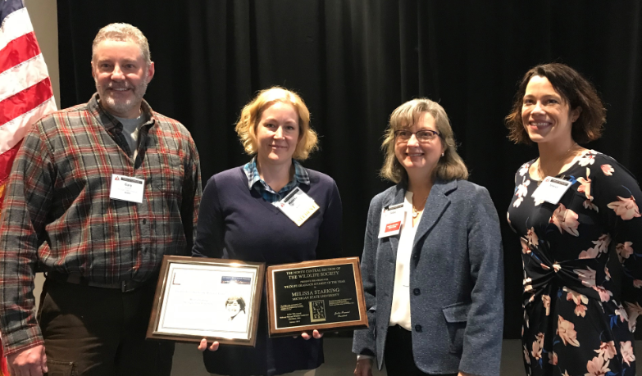
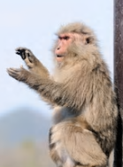
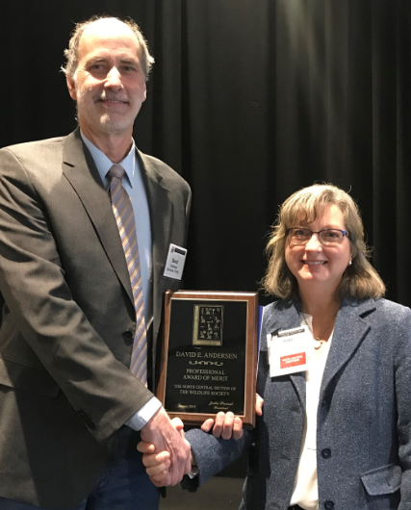
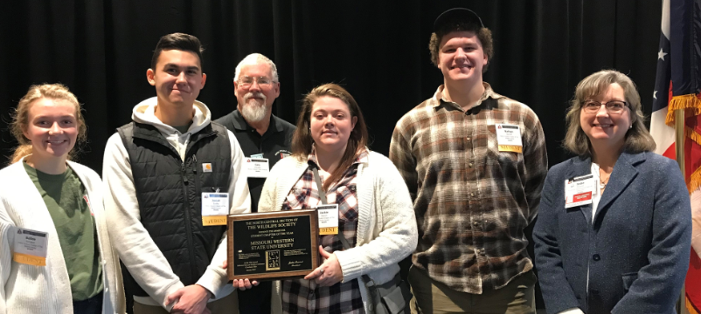
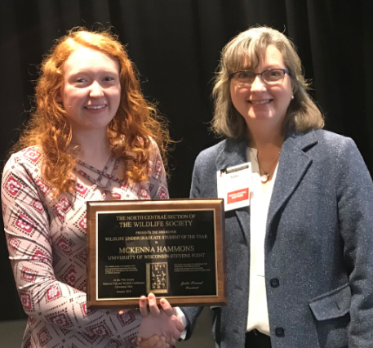
Recognition of our Fellow Wildlifers
Graduate Student
Professional Award of Merit
Undergraduate Student
Student Chapter of the Year
Notes:
Update these photos as needed each year! For 2018, Awards given at 2019 Midwest F&W Conf. in Cleveland were - Graduate Student – Melissa Starking, MI; Prof. Award of Merit – David Andersen, U of M Research Coop; Undergraduate Student - McKenna Hammons, U of W-SP; Student Chapter of the Year– MO Western State Univ.

Slide 14
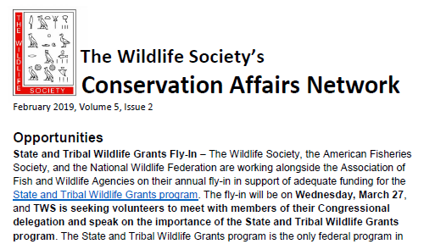
The Value of NCS -
A Smart Investment in the Future of Conservation
Conservation Affairs Network
Launched 2014 to engage, unify TWS efforts of 200+ units, nearly 10,000 members
Creates venue for streamlined communication, collaboration, and cooperation on policy matters through Conservation Affairs Committees in Sections and Chapters that identify and addressing policy.
NCS priorities submitted fall 2018 –
Top priority - funding for wildlife conservation and mgt.
Loss of habitat to urban/suburban and agricultural development
Promoting the value of public lands
Notes:
Update CAN activity examples as needed. Encourage participating in the Fly In to DC to lobby for State Wildlife Grant appropriations. State Chapters can add their invovlement.

Slide 15
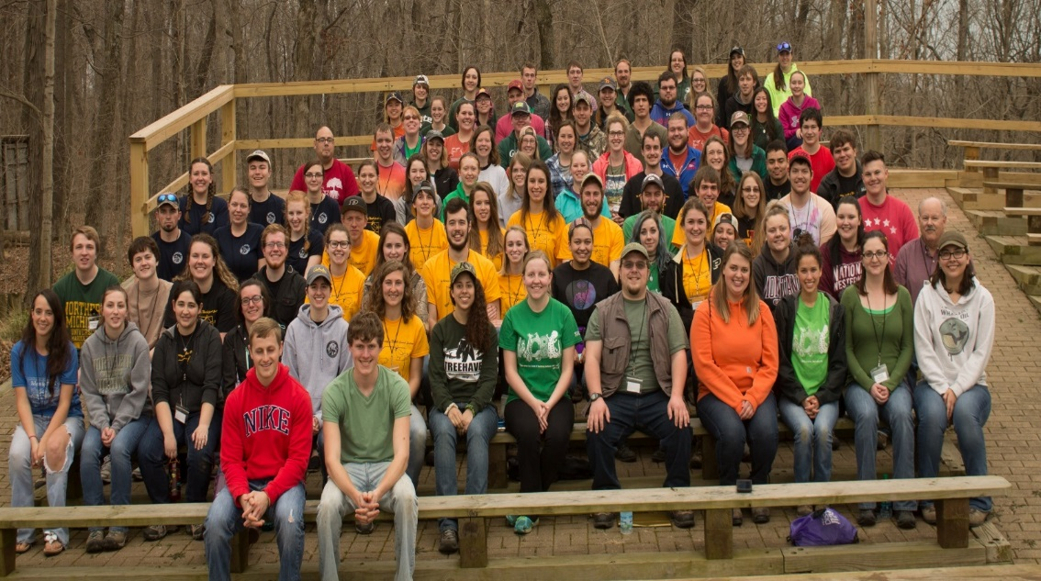
Student Conclave Supporting Our Community Now & for the Future
- Spearheaded by and geared for students. Rotates around our states.
Network, learn, professional growth and leadership experience.
Activities from bird banding to Quiz Bowl to bonfires – FUN!
2017 Conclave at Purdue
Notes:
Update Conclave photo as feasible. Fond memories of Conclave - give your memories as a student. NCS Bd considering facilitating a rotating state schedule so student chapters can know to plan ahead and with each other in a state to host it. Sadly no Conclave this spring 2019 since no host(s) stepped forward.

Slide 16
Where Do Our NCS Dues Go?
Notes:
The time and talents we each bring are priceless, far beyond a $20 membership ($10 retire, $10 students), however dues are essential to our operations and meeting our mission. The NCS fiscal year runs from July 1 to June 30. The funds available on July 1 should be ≥$4,750. This amount represents committed operating costs (all of which may not be fully realized) for a typical year of the NCS. Typical encumbered expenses for an NCS operating year include those on slide. See spending plan at http://wildlife.org/wp-content/uploads/2015/12/NCSTWSFiscalPlan.pdf

Slide 17
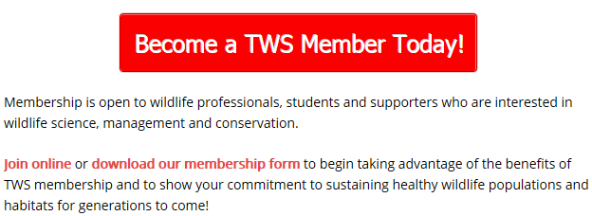
Get Involved!
Join! - Learn more at wildlife.org/join
Notes:
Don’t sit on the sidelines – get involved! Can download, complete and mail in membership form with check to join just NCS, or do on line. NCS dues $20 regular (for comparison - WI dues $10, MN $25 – add your state dues in as comparison)

Slide 18
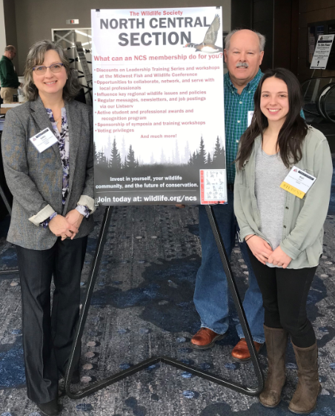
Get Involved!
Join a Committee/Team
- Membership (Jodie Provost)
- Conservation Affairs (Peter Fasbender)
Professional Development (Gary Potts)
Awards (Tyler Harms)
Nominations & Elections (Gary Potts)
Some of our NCS Membership Team at the 2019 Midwest FWC, Cleveland.
Notes:
Update Committees, their leads and photos as needed!
Great way to get your toes wet to test the water, to grease your wheel or cog, Our teams are what we make them. They are the behind the scenes muscle. Like “Team” better – no “I“ in it. This is our membership team of Gary Potts, Kali Rush, me, plus Katy Reeder, Kristin Black, Dan Stephens, and Craig Miller

Slide 19
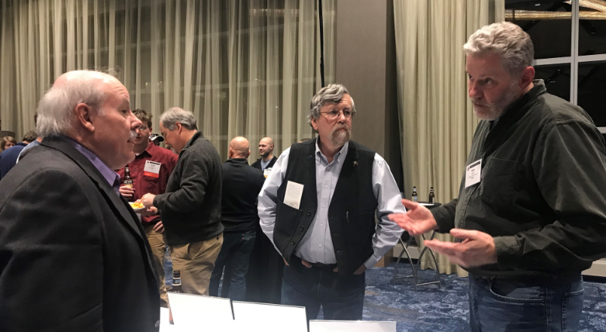
Get Involved!
Serve on our Executive Board
- President (Gary Roloff)
President-Elect (Olivia LeDee)
Past President (Jodie Provost)
Secretary (Jon Cepek)
Treasurer (Kyle Daly)
8 State Chapter Presidents
Undergraduate Student Rep
(Lindsey Figg)
Graduate Student Rep (Kali Rush)
or as our Representative to Council (John Moriarty)
Notes:
Update Officers and Rep photos and names as needed each year!
Exec Bd are elected, voting members - the finest people to care and work along and laugh along with. They make you better. We make each other better! Photo is Gary Potts Past TWS President, John Moriarty NCS Rep to Council, and Gary Roloff, new NCS President, thinking great thoughts.

Slide 20
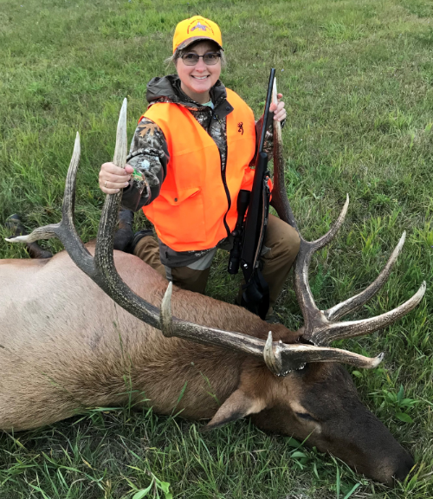
We don’t need to accomplish great feats, simply small feats with great care for our mission. Always open to ideas & input! NCS Membership Team Lead, Jodie Provost jodie.provost@yahoo.com, 218-838-3553 Thank you! for the chance to share and all you each do for TWS.
Notes:
Update presenter contact info and photo as needed.
Thank you for inviting me and for all you do for TWS!

Slide 21
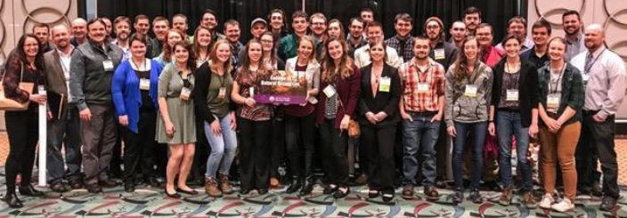
We are the Cogs and Wheels!
“We are The Wildlife Society!”
- Gary Potts, TWS Past President
Notes:
Change state chapter logo as needed. Here over 50 U of W- SP “Pointers” attend the 2018 MFWC in Milwaukee.. Shout it! Aldo would be proud of we cogs and wheels!
Gary Potts coined “We are The Wildlife Society” phrase. At the end, divide the audience into thirds, and holler “We are” and point to each third to say “T”, “W”, “S”!!

